Slide 1
Chatbot Use Cases

Slide 2
Chatbot Use Cases
Cautionary Tale

Slide 3
Summary of Use Cases
Strategy: Company strategy and priorities bot
Product: Product Roadmap Bot (what's coming, when, what you need to know)
Marketing: Marketing Ops Documentation
Sales: Sales Enablement Bot (product description, positioning strategy, key talking points, etc.)
Finance: Quarterly Financial Results
Execution: Project Portfolio Status Updates
Customer Support: Customer Service On-Boarding Bot
HR: HR Benefits Bot
Operations: Ops KPI Bot
Customer Comms: Customer Communications & Press Release Bot

Slide 4

Strategy
Potential Impact: <describe impact>

Slide 5
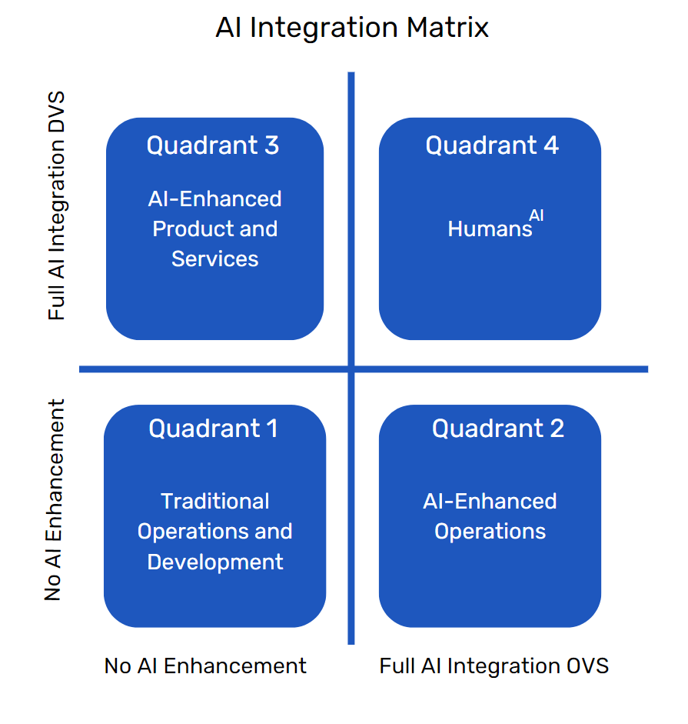
Where do you want to start – internal vs customer facing bots

Slide 6
Q&A

Slide 7
Coding Exercise
> git clone https://github.com/marty916/Enterprise-LLM-RAG.git
> cd Enterprise-LLM-RAG/lessons/02-usecases

